Slide 1
Lecture # 5 (Final) Control Logic Design Micro-program, flow-chart, state-diagram

Slide 2
Introduction
The process of logic design is a complex undertaking.
The data processor part may be general purpose processor unit
The data processor may consist of individual registers and associated digital functions
The control logic initiates all micro-operations in the data processor.
The control logic is a sequential circuit whose internal states dictate the control functions for the system by generating the signals for sequencing the micro-operations.
Fig. 10.1 Control logic and data processor interaction

Slide 3
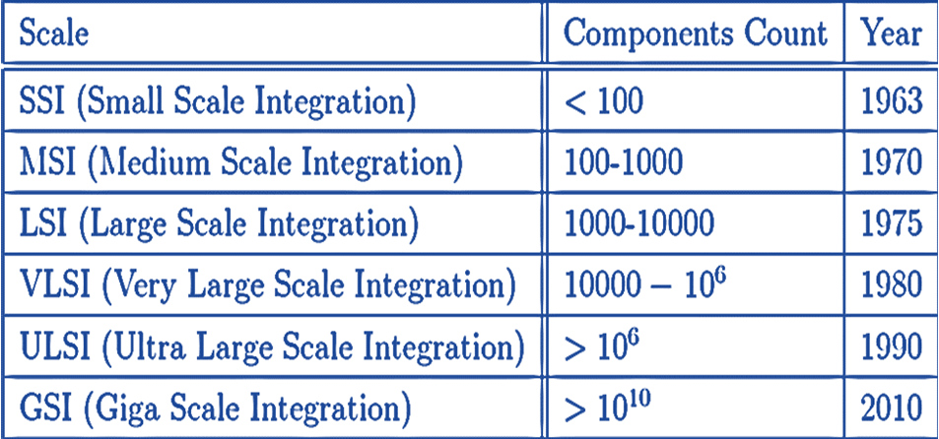
Control Organization
Methods of Control Organization
One flip-flop per state method
Sequence register and decoder method
PLA control
Microprogram control
The first two method must use SSI and MSI circuits for the implementations.
PLA or microprogram which uses an LSI device.

Slide 4
Microprogram Control
The purpose of the control unit is to initiate a series of sequential steps of microoperations.
A control unit whose control variables are stored in a memory is called a Microprogrammed Control Unit (MCU).
Each control word of memory is called a microinstruction.
A sequence of microinstructions is called a microprogram.

Slide 5
Hard-wired Control - Example
The design is carried out in five consecutive steps-
The problem is stated
An initial equipment configuration is assumed
An algorithm is formulated
The data processor part is specified
The control logic is designed

Slide 6
1. Statement of the Problem
Addition and subtraction of binary fixed point numbers when negative numbers are in sign 2’s complement form.
The addition of two numbers stored in registers of finite length (8 bits) may result in a sum that exceeds the storage capacity of the register by one bit.
The extra bit is said to cause an overflow.

Slide 7
2. Equipment Configuration
The two signed binary numbers to be added or subtracted contains n bits.
The magnitudes of numbers contain k = n – 1 bits and are stored in registers A and B.
The sign bits are stored in flip-flops named A_{s} and B_{s}.
Fig. 10-6 Register and associated equipment configuration for the adder-subtractor

Slide 8
2. Equipment Configuration
The ALU performs the arithmetic operations and the 1-bit register E serves as the overflow flip-flop, where the output carry is transferred.
It is assumed that the 2 numbers and their signs have been transferred to their respective registers and that the result of the operation is to be available in registers A and A_{s}.
Two input signals in the control logic specify the add (q_{a}) and subtract (q_{s}) operations.
One output variable x indicates the end of the operation.

Slide 9
2. Equipment Configuration
The control logic communicates with the outside or external environment through the input and output variables.
Control logic recognizes input signals, q_{a} or q_{s} and provides the required operation.
Upon completion of the operation, the control logic informs the external environment with the output, x that the sum or difference is in registers A and A_{s} and the overflow bit is in E.

Slide 10
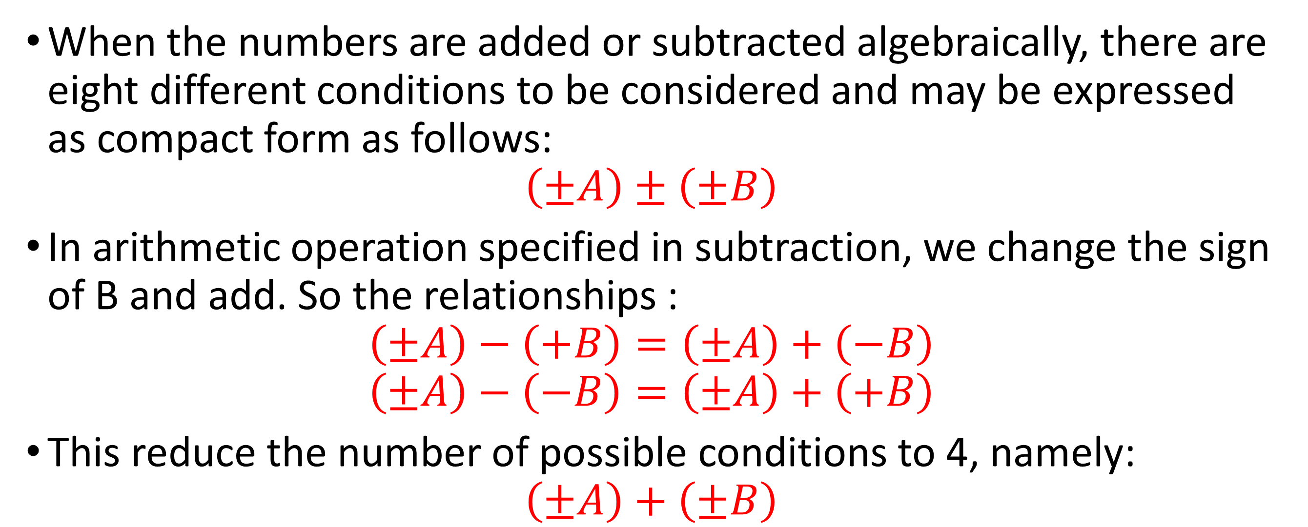
3. Derivation of the Algorithm
When the numbers are added or subtracted algebraically, there are eight different conditions to be considered and may be expressed as compact form as follows:
$$\left(±A\right)±\left(±B\right)$$
In arithmetic operation specified in subtraction, we change the sign of B and add. So the relationships :
$$\left(±A\right)−\left(+B\right)=\left(±A\right)+\left(−B\right)$$
$$\left(±A\right)−\left(−B\right)=\left(±A\right)+\left(+B\right)$$
This reduce the number of possible conditions to 4, namely:
$$\left(±A\right)+\left(±B\right)$$

Slide 11
3. Derivation of the Algorithm contd….
When the signs of A and B are the same, we add the two magnitudes, and the sign of the result is the same as the common sign.
When the signs of A and B are not the same, we subtract the smaller number from the larger and the sign of the result is the sign of the larger number.

Slide 12
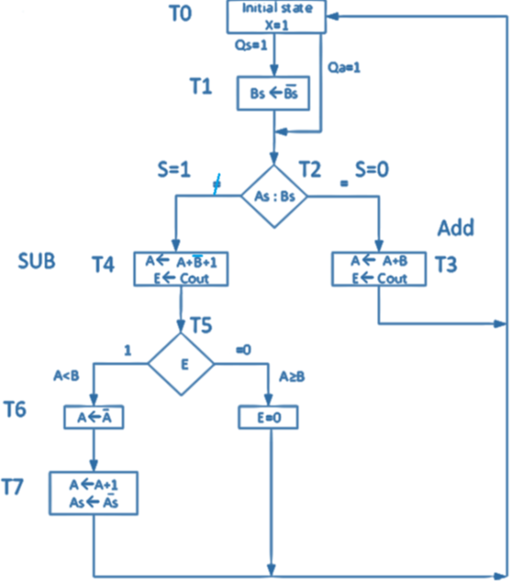
Flowchart and state diagram for sign magnitude addition and subtraction operation
Fig. 10-7 Flow chart for sign-magnitude addition and subtraction operation with the equipment of Fig. 10-6

Slide 13
Explanation of the Flowchart and State Diagram
1. An operation is initiated by either q_{s} or q_{a} inputs
2. Input q_{s} initiates a subtraction operation, so sign of B is complemented
3. Input q_{a} initiates an addition operation, so sign of B is left unchanged
4. Then two signs are compared, A_{s}:B_{s} symbolizes this decision, if two signs are equal then the path marked with = sign is chosen; otherwise the path marked with ≠ sign is chosen

Slide 14
Explanation of the Flowchart and State Diagram
5a. If signs are equal then the contents of A is added to the contents of B, and the sum is transferred to A. The value of the end carry is an overflow, as such the E flip-flop is made equal to the output carry, C_{out}.
5b. If signs are not the same then the contents of B is subtracted from the contents of A, this is done by adding A to the 2's complement of B and the sum is transferred to A. The value of the end carry is zero, that is, there is no overflow, as such the E flip-flop is cleared to zero, indicating that A ≥ B, and the number in A is the correct result. The sign of the result is equal to the original value of A_{s}.

Slide 15
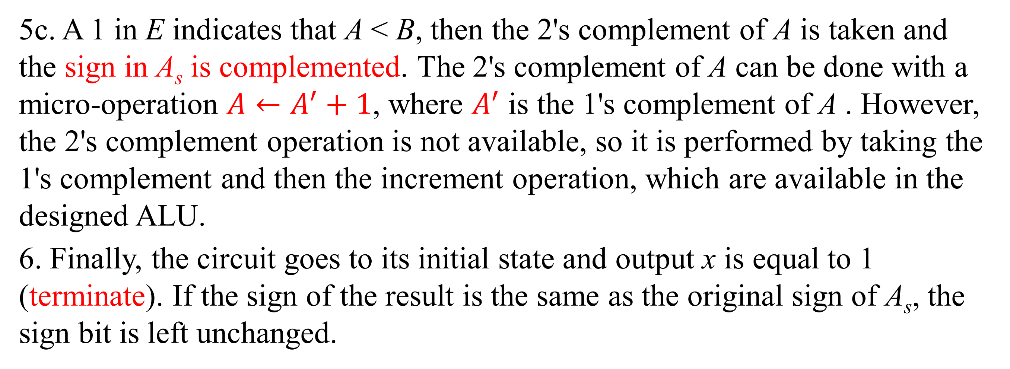
Explanation of the Flowchart and State Diagram
5c. A 1 in E indicates that A < B, then the 2's complement of A is taken and the sign in A_{s} is complemented. The 2's complement of A can be done with a micro-operation $A←A^{′}+1$, where $A^{′}$ is the 1's complement of A . However, the 2's complement operation is not available, so it is performed by taking the 1's complement and then the increment operation, which are available in the designed ALU.
6. Finally, the circuit goes to its initial state and output x is equal to 1 (terminate). If the sign of the result is the same as the original sign of A_{s}, the sign bit is left unchanged.

Slide 16
4. Data Processor Register
The operations between A and B can be done with the ALU.
The operations with A_{s}, B_{s} and E must be initiated with the separate control variables.
Fig. 10-8 (a) Data Processor Registers and ALU

Slide 17
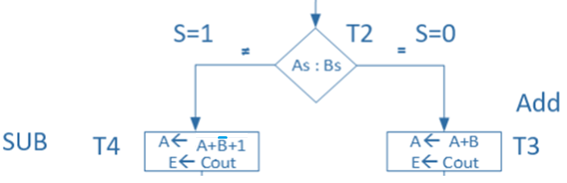
5. Control Block Diagram
The control logic block receives five inputs: two from the external environment and three from the data-processor.
To simplify the design, we define new variable S:
S = A_{s} XOR B_{s}
Fig. 10-8 (b) Control Logic Block Diagram

Slide 18
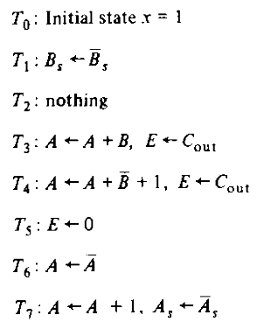
Control State Diagram

Slide 19
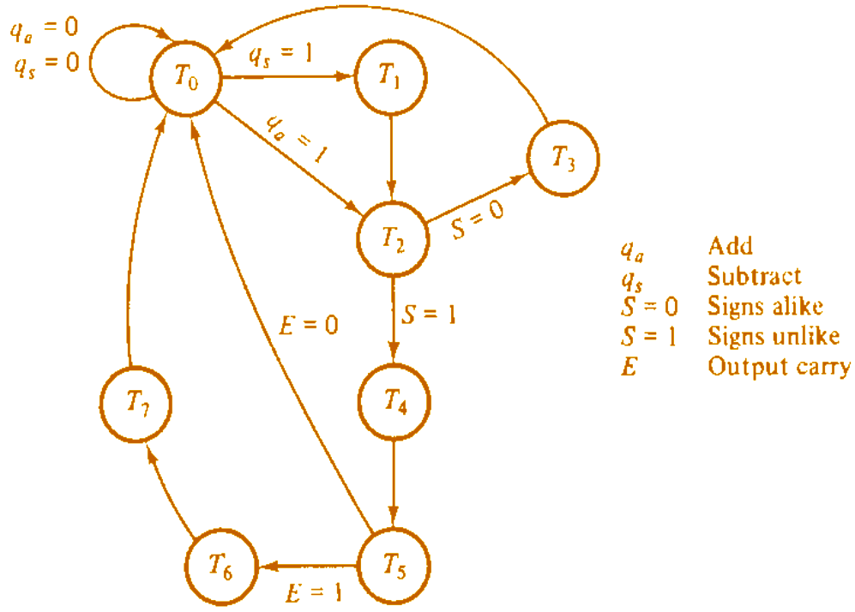
Control State Diagram
Fig. 10-9 (a) State diagram for register transfers

Slide 20
Control State Diagram
We start by assigning an initial state, T₀, to the sequential controller. We then determine the transition to other states T₁, T₂, T₃, and so on.
For each state, we determine the micro-operations that must be initiated by the control logic circuit.
This procedure produces the state diagram for the controller circuit together with a list of register-transfer operations, which are to be initiated while the control logic circuit is in each and every state.

Slide 21
Sequence of Register Transfers
Fig. 10-9 (b) Sequence of register transfers

Slide 22
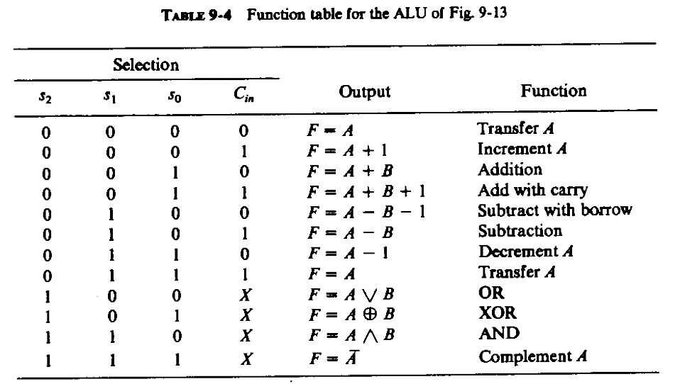
Sequence of Register Transfers
Logical disjunction (∨)
Logical conjunction (∧)

Slide 23
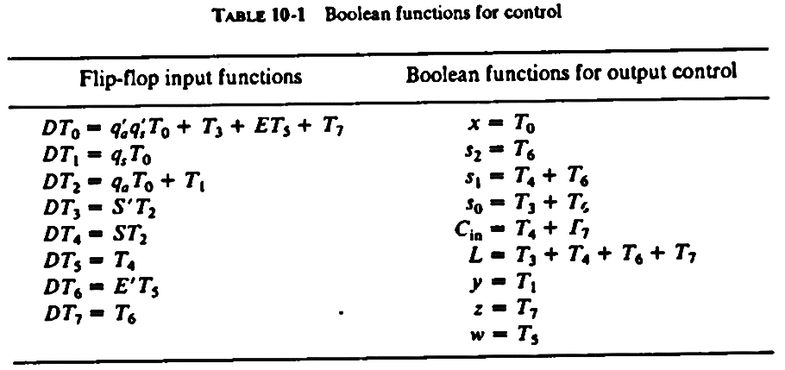
Sequence of Register Transfers
Logic Equations for Hardwired Control Unit Boolean Functions for Output Control
Fig. 10-8 (b) Control Logic Block Diagram

Slide 24
Thanks for Attending….
?

